Slide 1
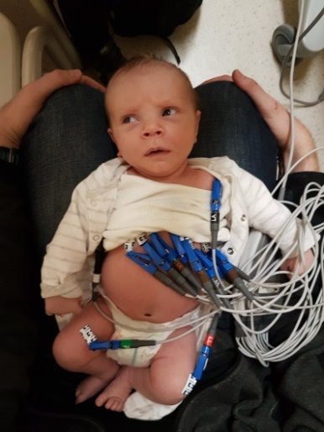
ECG IN CONGENITAL HEART DISEASE
Dr.Muhammad Ameen C
Senior Resident Cardiology
GMCH Kozhikode

Slide 2
Outline
Introduction
Waves and intervals
Situs
Right to left shunts
Obstructive lesions
CCHD
Miscellaneous

Slide 3
ECG
Reflects the hemodynamics
Reveals the underlying physiology
Helps to cross check ECHO
Cost effective tool to suspect and diagnose CHD
A hemodynamically significant structural heart disease may exist with insignificant ECG changes

Slide 4
ECG Utility
Malposition
Chamber enlargement
Pericardial and myocardial diseases
Conduction abnormalities
Arrhythmias
Electrolyte imbalance

Slide 5
Requirements
Competent,patient and dedicated technician
Cooperative child
Small electrode (half inch)
Additional leads

Slide 6
Tips for recording
Limb leads may be placed more proximally - less movement artefacts
V3R,V4R to display RV potentials
Half gain(5mm/V) – if the complexes are large
Sedation/sleep
Notes:
Rv bulges to rt side

Slide 7
Standardization
Half std precordial leads

Slide 8
Pediatric vs Adult ECG
RV dominance is the rule(till 3yrs)
RAD
Tall R in V1 and aVR
T↓ in V1-3 (juvenile T waves)
Upright T in V1 is abnormal after 3days
Short conduction intervals (small heart)
High resting HR
New born: 110-150/min
1 year: 100-130/min
5 years: 90-110/min
10 years: Adult HR

Slide 9
P Wave
Amplitude : <3mm
Duration :
Infants: <70ms
Children: <90ms

Slide 10
BAE
Cor triatriatum
Congenital MS
Lutembachers syndrome
Endocardial cushion defect

Slide 11
PR interval
Birth: 80-160ms
1 yr: 70-150ms
5 yrs: 80-160ms
10yrs: 90-170ms

Slide 12
PR Interval
Short PR
Pre-excitation-Ebstein’s,Tricuspid atresia
Glycogen storage disease
DMD
Variable PR
Wandering pacemaker
Mobitz type 1 AV block
Prolonged PR
ECD
ASD
Ebstein’s
CCTGA

Slide 13
Q Wave
Normal
20-30ms
<0.5mV in left precordial leads & aVF
<0.8mV in lead III in children <3 years
Abnormal
Right precordial leads(RVH/ventricular inversion)
Deep(hypertrophy of volume overload)
Deep and wide(MI or fibrosis)
Absent in left precordial leads(LBBB/ventricular inversion)

Slide 14
QRS
Frontal loop
Counter clockwise:initial q in I,aVL (inlet VSD, ECD,Tricuspid atresia,DORV,Single ventricle)
Clockwise :initial q in II,III,aVF
Ventricular forces
RV force: R in V1,V3R,V4R,S in V5,V6
LV force: S in V1,V3R,V4R,R in V5,V6
BV force: Katz Wachtel phenomenon
Stereotypical QRS in single ventricle

Slide 15
QRS Duration
Upto 1 year: 50-70ms
1-3 years : 60-70ms
3-8 years : 70-80ms
8-16 years : 70-100ms

Slide 16
Clues from QRS
RV Enlargement
Volume overload:RBBB,RAD
Pressure overload:Monomorphic R/RR’,deep T↓ in RPLs
LV Enlargement
Pressure overload:LVH with strain
Volume overload:LVH with deep q in lateral leads

Slide 17
ST Segment
Normal
Limb lead ST deviation upto 1mm
Left precordial lead upto 2mm
Upsloping ST depression
BER:concave ST elevation with upright T
Abnormal
Downsloping ST with biphasic T
Horizontal ST depression >80ms

Slide 19
T Wave
First week: upright in all precordial leads
After 1st week: T↓V1-3 (until 8yrs)
Persistent juvenile pattern is possible till early adulthood
CCTGA: may have upright T in all precordial leads due to side by side ventricular relation
DTGA: may have upright T taller in V1 due to systemic RV

Slide 20
QTc
<6months : <490ms
>6months : <440ms

Slide 21
Chamber enlargement in newborn
RVH
S in lead I>12mm
R in aVR>8mm
V1:pure R>10mm, qR, upright T
RAD>180˚
LVH
LAD
Voltage criteria
Q in V5,V6>5mm with tall T

Slide 22
Pediatric LVH

Slide 23
Normal Axis

Slide 24
Extreme Axis
Normal : <1%
OP ASD
AVSD
Ebstein’s
Tricuspid atresia
Noonan syndrome
WPW syndrome

Slide 25
Normal findings in children
HR > 100/min
QRS axis > 90
Right precordial T inversion (juvenile T wave)
Dominant right precordial R waves
Inferior and lateral Q waves
Short PR (<120ms) and QRS (<80ms)
Slightly peaked P waves (<3mm)
Slightly long QTc (<490ms)
Respirophasic sinus arrhythmia
Shifting atrial pacemaker

Slide 26
Normal pediatric ECG

Slide 27
Preterm infant
Lesser amplitude in limb leads
Less RV dominance
More leftward forces
More leftward QRS axis
Higher incidence of deep Q in V6

Slide 28
Rotation

Slide 30
Case 1
13y boy
Met with RTA
Minor chest wall injury
Called for abnormal ECG

Slide 31
Diagnosis?
Situs inversus-dextrocardia

Slide 32
Confirm Situs
P wave direction: viscero-atrial situs
Situs solitus:Upright P in I,aVL
Situs inversus:Inverted P in I,aVL
Can be altered by left atrial ectopic focus: “dome and dart” P in V1

Slide 33
Cardiac position
Precordial R progression
Levocardia: R progresses from V1 to V6
Dextrocardia: R regresses from V1 to V6
Mesocardia: mid precordial leads show tallest R waves

Slide 35
Malpositions
Notes:
4th malposition is mesocardia
Situs a/c to dta,la,stomach
Cardia a/c to apex

Slide 37
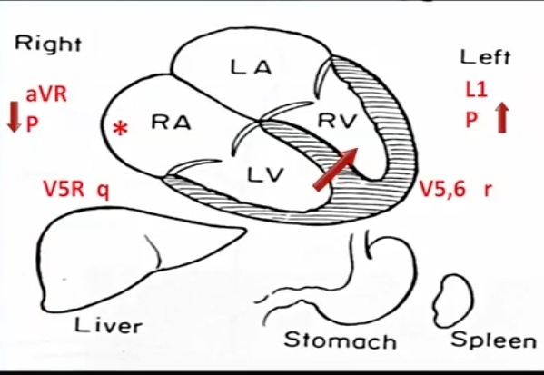
Ventricular Relation
Septal q waves in lateral leads in normal heart
Absence may be a subtle sign of ventricular inversion

Slide 38
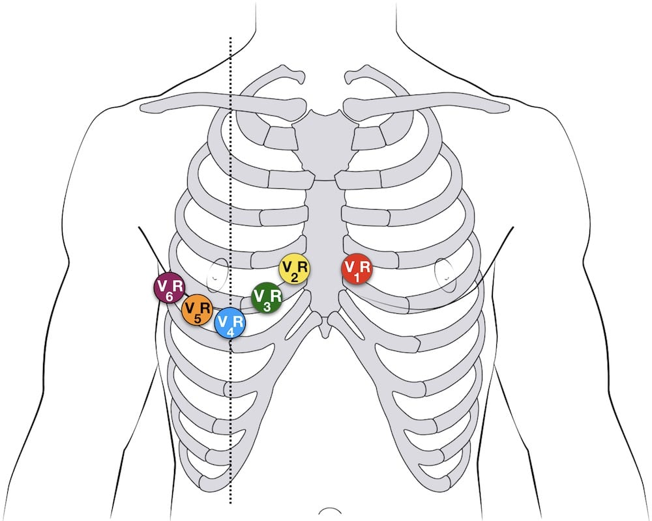
Situs inversus-dextrocardia
Mirror image SAN
aVR resembles aVL
Septal Q waves in right lateraal leads
Correction:Arm and precordial leads are reversed

Slide 39
Situs solitus-dextrocardia
Atrial situs is normal-normal SAN position
Limb leads left unchanged
Precordial leads are recorded from right side

Slide 41
Case 2
10y girl
Atypical chest pain
Ordered ECG

Slide 42
Technical Dextrocardia
Notes:
Technical dextrocardia

Slide 43
Heterotaxy
Right isomerism
Paired sinus nodes
Can have 2 P morphologies
Right SAN is dominant
P wave axis is normal
Rarely left SAN can be dominant
Left isomerism
Absent or hypoplastic SAN
Ectopic atrial pacemaker
Superior P wave axis
Arrhythmia and block are common

Slide 44
Left to right shunts
Notes:
At the end ofexmn…

Slide 45
Case
3y boy
Recurrent LRTI
Systolic murmur at upper sternal border
Notes:
Increased pbf,no cyanosis

Slide 46
OS ASD

Slide 47
Normal p axis
rsR’ in v1
Stroke with PFO-chrochatage gives etiological correlation
First degree block in OS ASD- look for limb anomalies-familial ASD
OS ASD ecg with cyanosis-think of TAPVC

Slide 48
ASD
Notes:
LOCATION
Ra rv overload
shunt

Slide 49
Physiology
RV volume overload – RVOT enlarges – last to depolarise
Lengthening of RBB – incomplete RBBB
Increased QRS duration in older age
Clockwise electrical rotation
Lack of sinus arrhythmia in large ASD

Slide 50
Case 3
48y male
Frequent LRTI in childhood
Exertional palpitation and fatigue
NYHA II
MSM at base of heart
SpO2 96%

Slide 51
OP ASD
Maldevelopment of LAF – LAD with LAFB
Counter-clockwise loop
First degree heart block
OP ASD ECG with cyanosis:think of common atrium

Slide 52
SV ASD
Sa node pushed down
Depolarise below upward
Short PR interval-SAN close to AVN

Slide 53
ASD | V1 QRS | P IN INFERIOR LEADS | QRS AXIS
OS | rSR | + | R/N
OP | rSR | + | L
SV | rSR | - | R/N
COMMON ATRIUM | rSR | - | L

Slide 54
Shunt
>2:1 if
Prominent terminal R in V1
RAD
Chrochetage sign
After surgery R may revert to rsR’

Slide 55
VSD
Site: ECD
Size:
Small:normal ECG
Moderate:LA,LV overload
LV diastolic overload – V5,V6
Tall R
qR, prominent q(4-10mm)
LAE:broad,notched P wave
RV diastolic overload
rsr’ or Rsr’ in V1
T upright

Slide 56
Katz-Wachtel phenomenon
Notes:
Neg qrs in 1,avl –rad due to rvh

Slide 57
VSD
RV systolic overload
Tall R in V1
Katz Wachtel phenomenon
Equidiphasic complexes in V2-V4 (R+S>60mm)
Large shunt
Biventricular hypertrophy
Time to intervene

Slide 58
Case 4
19m boy
CHF in infancy,now improved
Soft systolic murmur,PAH
CXR-cardiomegaly,borderline plethora, prominent PAs

Slide 59
Eisenmenger?
VSD with rvot obstruction developing later?

Slide 60
Tall P
CCW loop
RAD
RV dominance
AVCD with Eisenmenger

Slide 61
Eisenmenger Syndrome
PAH
RV systolic overload
RAE

Slide 62
Eisenmenger physiology
L->R going to Eisenmenger
Initial heart failure improves subsequently
PAH features dominate thereafter
R->L going to Eisenmenger
Present much earlier with cyanosis and HF
Cyanosis deepens as Eisenmenger sets in

Slide 63
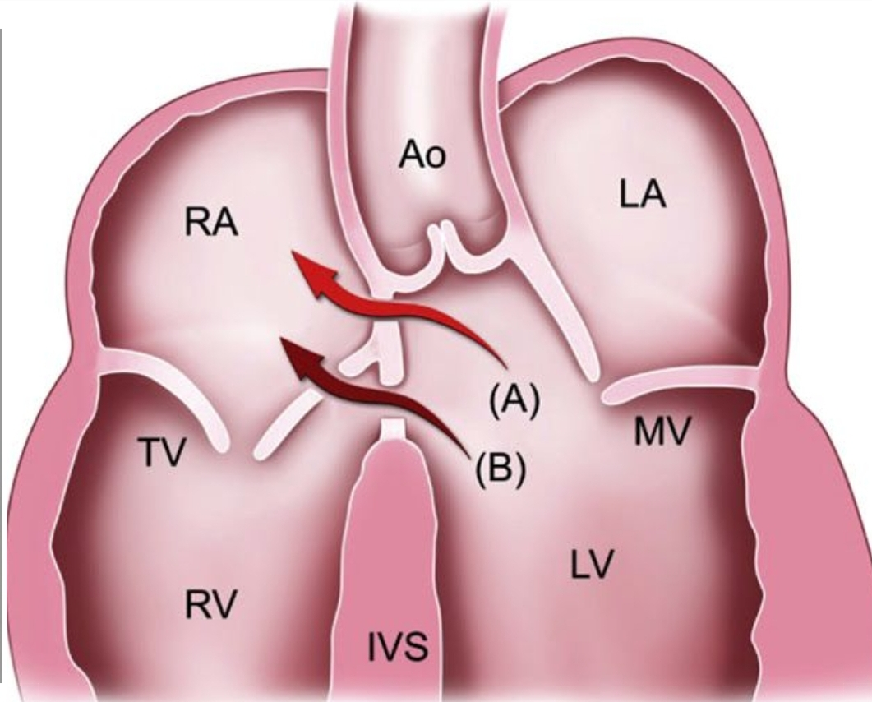
Gerbode’s defect
RAE with LV volume overload

Slide 64
Case 5
6y old
CHF
Recurrent LRTI since infancy
PSM+
No cyanosis
CXR-cardiomegaly,plethora

Slide 65
CCW LOOP with lad-avcd/inlet vsd
Significant q in lat leads-good pbf,hyperkinetic pah-operable

Slide 66
ECD
Counter-clockwise loop
First degree AV block
Superior QRS axis
RVH/RBBB

Slide 67
Case 6
50y old lady
Exertional dyspnoea and palpitation
SPO2 98%
Continuous murmur with prominent diastolic component in pulmonary area

Slide 68
PDA

Slide 69
PDA
Size
Small:normal ECG
Moderate:LVH
Large:BVH
LAE
PAH - Eisenmenger

Slide 70
AP Window
Similar to PDA or nonrestrictive VSD

Slide 71
Left to right shunt physiology
Condition | Features | Comments
Pretricuspid
ASD | RV volume overload | Presents late
Posttricuspid
VSD | LV volume overload | Presents earlier
 | CCW loop in ECD and inlet VSD
PDA,AP window | LV volume overload | Presents early Continuous murmur

Slide 72
Obstructive lesions

Slide 73
Pulmonary stenosis
Mild PS earliest sign: absent T inversion in V1 after 4days of life
RAD,RAE,RVH in moderate PS
PR prolongation due to RAE
V1: rsr’-rsR’-R/qR
RVH with strain in severe PS
Neonate with critical PS:LVH (hypoplastic RV)

Slide 74
PS Gradient
Tall R in V1 > 20mm: >100mm Hg(R heightx5)
Tall P suggestive of RAE: >120mm Hg
ST-T changes in precordial leads: >150mm Hg

Slide 75
Severe PS

Slide 76
Noonan syndrome
Dysplastic pulmonary valve stenosis
Extreme axis deviation
Wide,splintered QRS
QS in inferior and left leads
Notes:
Lad-ps+rubella

Slide 77
DCRV
Subinfundibular PS
Smaller portion of RV is in high pressure compartment
Degree of RVH in V1-3 is less than expected based on severity of stenosis

Slide 78
Congenital AS

Slide 79
At birth: Severe AS/Coarctation
Notes:
Rvh due to intrauterine rv overload
No lvh in first yr
Lv +-strain

Slide 80
Coarctation
LAE
LVH
LV strain in infancy-indication for intervention

Slide 81
Cor triatriatum
Prox high pressure chamber
Distal low pressure chamber
PAH
RAD
RVH
P pulmonale
Notes:
pah

Slide 82
CCHD
Increased PBF
RV Dominant:TGA,SV,TAPVC,common atrium
LV Dominant:TA without PS,SV
BV Dominant: Truncus,SV
Normal/Decreased PBF
Dominant LV
Tricuspid Atresia-VSD-PS/Pulmonary atresia with intact IVS
Dominant RV
Pulmonary hypertension present-Eisenmenger
Pulmonary hypertension absent-TOF,DORV-VSD-PS

Slide 83
TGA
Early presentation
Severe cyanosis
RVH,RAD
MORE PBF LESS CYANOSIS
MORE SHUNT MORE HF
Post atrial switch-sinus brady/junctional rhythm,RVH
Post arterial switch:normal ECG
Post rastelli:RBBB

Slide 84
Case 7
39y lady
Class II DOE-long standing
Systolic murmur-upper sternal border
CXR-mild cardiomegaly,normal PBF
Notes:
Mc chd asso with mesocardia-cctga

Slide 85
Mesocardia
Q in v1,III
Absent q in v6
Ventricular inversion
CCTGA-VSD-PS

Slide 86
ccTGA
Q in V4R and V1
Absent Q in V5,V6
AVN out of Koch’s ∆
Varying heart block
Abnormal septal activation
CHB in 30%
Upright T in all chest leads:side by side ventricles

Slide 87
Case 8
5y boy
Cyanosis since mid-infancy
No CHF
MSM at base
No cardiomegaly

Slide 88
CCTGA
Notes:
Cctga with rv dominance

Slide 89
TAPVC
RAD
RAE
RVH
Pre-tricuspid shunt: mild presentation unless obstructed
OS ASD ECG with cyanosis is the clue

Slide 90
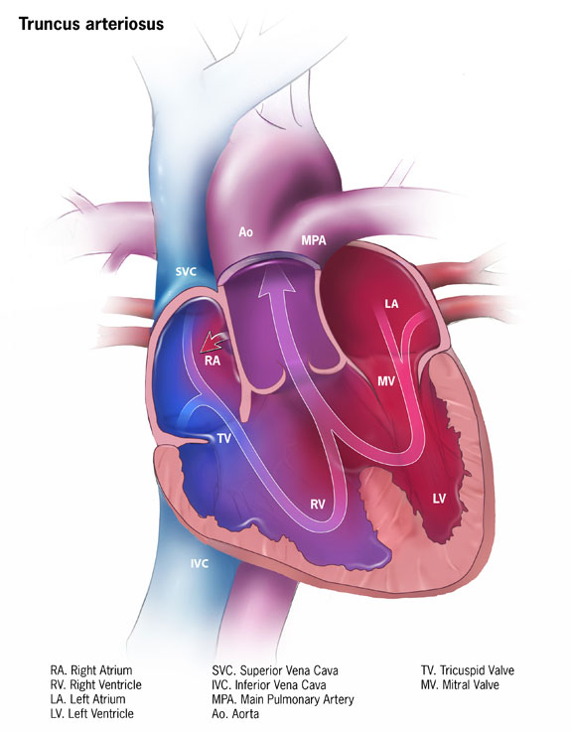
Truncus Arteriosus
BVH with strain

Slide 91
Case 10
13y girl
Hemoptysis
Found to have hole in heart during infancy
Cyanosis
Spo2:80%
Long systolic murmur in LSB and pulmonary area

Slide 92
CCW loop
Stereotypical precordial QRS

Slide 93
Single Ventricle
Unusual ventricular hypertrophy pattern
Similar QRS complexes-no IVS
Abnormalities in Q wave
Q in RPLs
No Q
Q in all precordial leads

Slide 94
Cyanosis with increased Qp
 | Features | Comments
D-TGA | RVH,RAD | Early presentation, severe cyanosis
TAPVC | RVH,RAD | Pre-tricuspid shunt. Mild presentation unless obstructed
DORV without PS | Can have CCW, RVH | A wide spectrum of ECG changes possible
Tricuspid Atresia with no PS | CCW loop,RAE,LVH | LV apex
Single ventricle without PS | Can have CCW,LVH,stereotypical qRS | A wide spectrum of ECG changes possible

Slide 95
Case 11
7 month baby
Cyanosis
Possible spells

Slide 96
CW loop
RV dominance
Typical V1-V2 pattern change
Sometimes V3R-V1 pattern change

Slide 97
TOF
Thickening of RV free wall: ↑R in V1
Thinning of RV trabeculum: ↓R in V2
Thickening of RV septum: ↑R in V3,V4
Pulmonary blood flow
Increased if PDA/collaterals
Presents as LV volume overload-q in V5,V6
If severe PS,PBF↓,rS in V5,clockwise rotation

Slide 98
Case 12
9y girl
Exertional fatigue
No spells/CHF
Mild desturation
To-and-fro murmur at pulmonary area

Slide 99
Prom R in v1-v6
CW loop
Tall p
TOF with absent PV

Slide 100
Case 13
3y boy
Cyanosis
Continuous murmur
No cardiomegaly
Spo2 80%

Slide 101
Pulmonary atresia with VSD
Same as TOF
Notes:
Same as tof
Pulmonary atresia with vsd

Slide 102
Post Op TOF
Advanced RBBB
injury of distal conduction system by surgery
QRS>180ms:Risk factor for SCD

Slide 104
Case 14
6y boy
No cyanosis
Spo2 90%
CHF in infancy
IE+
ESM at pulmonary area,soft P2

Slide 105
DORV

Slide 106
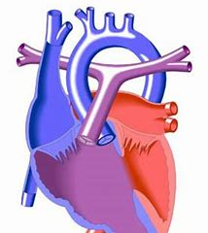
DORV
Varies with clinical type
RVH is universal
Subaortic VSD with PS:TOF like:RAD
Subaortic VSD with no PS:ECD like:LAD
Subpulmonic VSD:TGA like:RAD,RVH,LV volume overload,first degree AV block

Slide 107
Tips
PR prolongation and CCW loop- DORV rather than TOF
CCW loop with LAD and LV force- DORV without PS
As PS increases, QRS axis increasingly shift to right but loop remains CCW

Slide 108
Case 15
20 month
CHF
Systolic murmur
Mild cyanosis
CXR-cardiomegaly,increased PBF

Slide 109
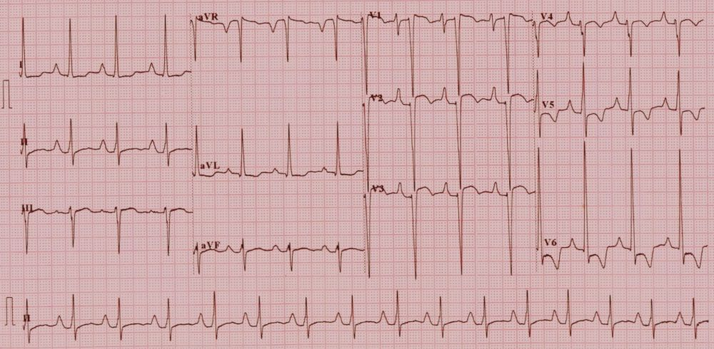
Tricuspid Atresia
CCW loop
LAD
No RV force
LV dominance

Slide 111
Case 16
7m
CHF
MSM+
Cyanosis
CXR-plethora

Slide 112
CCW loop
Some RV force
Tall p
Tricuspid Atresia with D-TGA

Slide 113
Tricuspid Atresia
Cyanotic child
RAE,LVH,LAD
Counterclockwise loop
With TGA
Better PBF
Can have LA forces and normal QRS
Usually VSD is non-restrictive with well developed RV
Notes:
TA-sperior axis
PA-normal axis
Lad-rv ill developed

Slide 114
Case 17
1y
Cyanosis, no spells
No CHF
Continuous murmur
CXR- decreased PBF

Slide 115
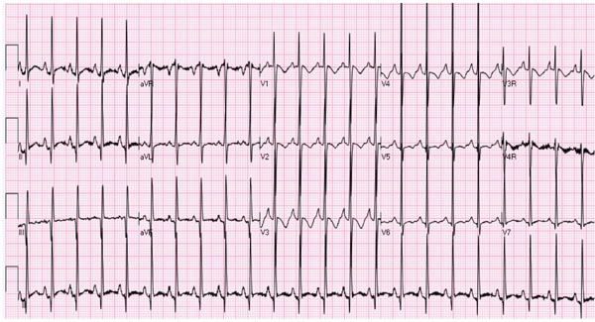
Pointed P-RAE
CW loop
Normal axis
Pulmonary atresia with intact ivs

Slide 116
Pulmonary Atresia with intact IVS
Cyanotic child
RAE,LVH
Normal axis or RAD

Slide 117
TOF physiology-Differentials and clues
TOF:soft P2,ESM in PA
VSD with PA:continuous murmur
PA with intact IVS:continuous murmur
DORV-VSD-PS:LV apex if VSD restrictive
CCTGA-VSD-PS:L posed aorta pulsation
DTGA-VSD-PS:more prominent cyanosis
TOF with absent PV:to and fro murmur
TOF with AVCD:MR murmur may be audible

Slide 118
Quick tips : Differentiating TOF physiology by ECG
Conditionl | ECG | Comments
TOF | RBBB, RAD ,V1-V2 abrupt transition
VSD Pulmonary atresia | LV forces less prominent unless MAPCA/PDA is flowing well | RBBB,RAD
Pulmonary atresia with intact IVS | Adult type precordial pattern with RV forces inconspicous unless RV dialated QR in V1 if RV dialated | Peaked P, RBBB/RAD may not be seen
TOF with absent pulmonary valve | Peaked P V1-V6 positive QRS | RAD, murmur declares the condition
Tricuspid atresia VSD PS | CCW loop LV forces dominant RAE | LV Apex striking ,no RAD
TOF with AVCD | CCW loop | Down Syndrome common
CCTGA VSD PS | Features of ventricular inversion | L-posed aorta may be palpable

Slide 119
miscellaneous

Slide 121
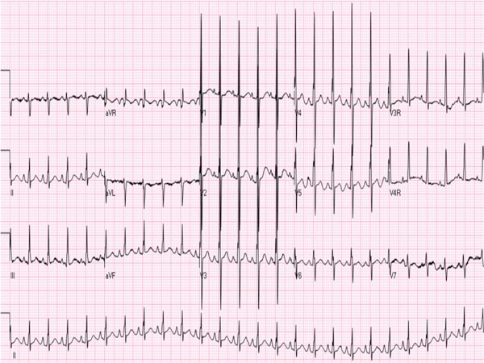
HLHS
RAD
RAE
RVH
ST-T abnormalities in left precordial leads

Slide 122
Case 18
10 month old boy
Asymptomatic
Evaluated for LSB murmur
No cyanosis
CXR: mild cardiomegaly, normal PBF

Slide 124
Ebstein Anomaly
High voltage P-Himalayan P wave(RAE)
Long PR interval (may be short when pre-excited)
Splintered QRS-atrialised RV
Atypical RBBB morphology
Initial q in V1 or even upto V4
Severe-aVR and V1 look alike
AF and Afl are common

Slide 125
Case 19
21d baby
CHF
No murmur
CXR-PVH,Cardiomegaly

Slide 127
ALCAPA
ALWMI pattern
Deep Q
Inverted T waves
LVH,LAD
Reversible LV dysfunction
May mimic DCM

Slide 128
Infarct pattern

Slide 129
THANK YOU

